Slide 1
Let’s Learn
Java by Bikash Shah

Slide 2
01
Data Types
Data types are divided into two groups:
Primitive data types - includes byte, short, int, long, float, double, boolean and char
Non-primitive data types - such as String, Arrays and Classes

Slide 3
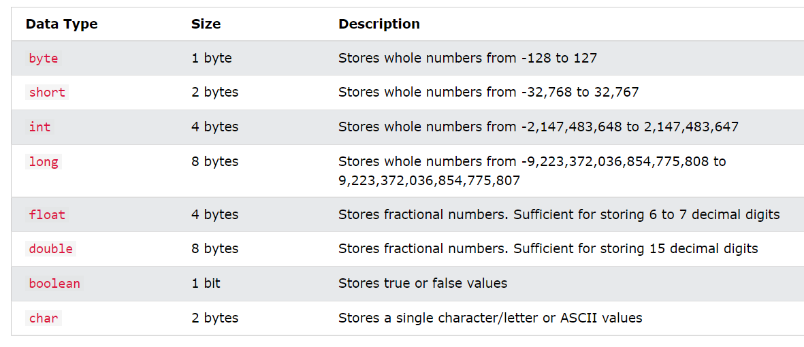
Primitive Data Types

